Slide 1
“Phoenix Data warehouse Solution”
Submitted By:- SURAJ KUMAR
Roll No:-13/CA/614
Reg. No:-20138402

Slide 2
Overview
Business Of The Customer
Problem And Issues facing by the Customer
Requirement Of The Customer
Abstract Description Of The complete Process
Database Diagram and E-R Diagram
A sequential step to complete the Process
Future Enhancement Of The Project

Slide 3
Business Of The Customer
Phoenix is a leading multinational medical instruments and consumer care producing company . With the increasing number of Clients and supplier they aim to monitor their sales , marketing, finance and budgeting decision .
Phoenix Medical Systems was created in 1989 with the goal of providing cost-effective and innovative solutions for the care of neonates. Phoenix is pioneer in India in the manufacture of products devoted to infant health care, the first product being an infant incubator. The mission of Phoenix continues to be to provide solutions that match the best in the world at very affordable prices.

Slide 4
Problem And Issues facing by Phoenix
Its very Difficult to Monitor the entire Business including Budgeting decisions, financial strategies , sales , Marketing in a very traditional approach .
As per the market Standard all the competitors are using Business –Intelligence .
Based on the Past reports using Reporting Tools it can analyse the current trend and predict the future in a profitable manner , which was not possible earlier .
Data is centrally loaded in a warehouse using which all the information can be fetched at 360 Rotation .
Unable to identify the product areas in which the strategies can be applied

Slide 5
Requirement Of The Customer
Data (Flat-Files/DB Files) from the multiple sources must be extracted ,Cleansed and Loaded into the warehouse with the use of ETL-Tool .
Identify incomplete, incorrect, inaccurate, irrelevant, etc. parts of the data and then replace, modify, or delete this dirty data or coarse data.
Transformations must be applied in order to make the necessary changes in the product . Ex- Supplier Id should be started by concatenating ‘S’ and auto incremented by 1 starting from 1001 i.e resulted as ‘S1001, S1002, S1003…..’ .
After the data has been cleansed and transformed into a structure consistent with the requirements, data is ready for loading into the data warehouse.
The data warehouse is used to analyse the data and create various reports based on the business requirements.
The reports are represented as per the business requirement i.e dashboards, visual displays- chart, list, crosstabs.

Slide 6
Abstract Procedures To Complete the Requirement
We have to create the tables as per needed by the client , in this case we are using total 12 tables . Location,Supplier,Employee,Product,ProductStock,Component,ComponentStock,SupplyType,Store ,Order,Sales….
The data will be contained in flat files and DB .
After creation of table it needs to be Extracted from the sources and after Cleansing and formatting Proper Transformation must be applied to the extracted source in order to meet the Business Requirement.
For Extraction we are using Informatica 9.5.1, for Reporting IBM Cognos 10.1 and for backend we are using MS SQL SERVER 2008 .
A sample fig. illustrating E-R AND Database Diagram.

Slide 7
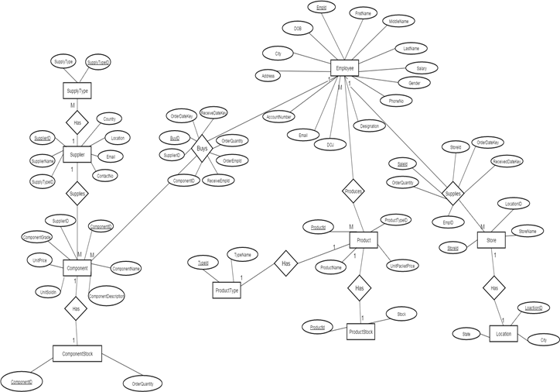
Fig. Illustrating E-R Diagram

Slide 8
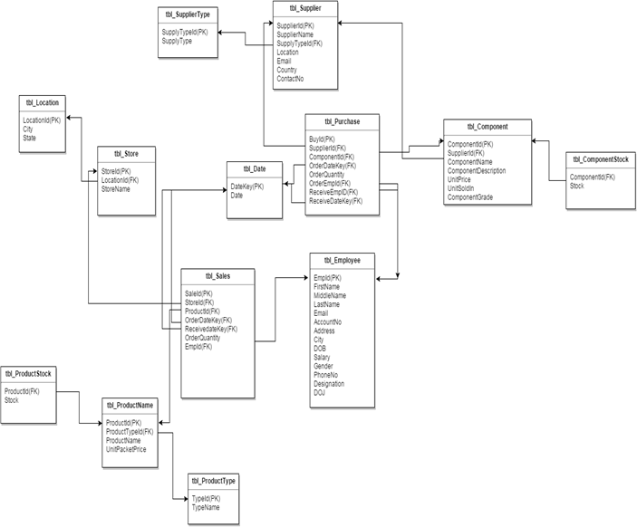
Fig. Illustrating Database Diagram

Slide 9
Step 1
Hence now we are done with all the tables and schemas , so we will start working with Informatica .
The Below Diagram illustrates the designer part of Informatica Tool where a table is extracted and Proper Transformation Is applied .
In order to complete the Transformation according to the Business contrast we have to use some Transformation which will lead it towards the expected result.
The Fig. displays the Mapping of informatica where we have used Joiner ,Sequence generator,Filter SQ, Expression Transformation and connected it with the Target Table .

Slide 10
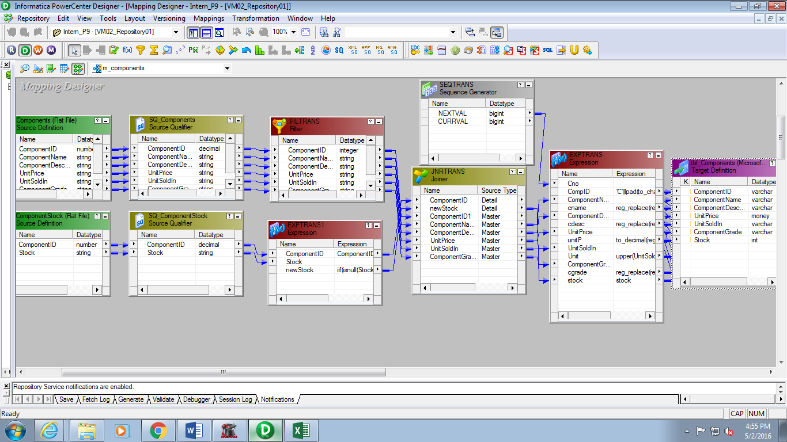
Fig. Illustrating the Informatica Designer

Slide 11
Steps 2
After completion of the mapping we need to create session in Workflow Manager.
While creating session we have to also provide the source and Target Path from where the tables had been extracted respectively .
In this case we have appended all the sessions sequentially from beginning to end according to the project requirement .
Next We have to run the Workflow in workflow manager so that we can check weather the created session for the respective mapping is valid or Not .
If the session is valid then it will Run successfully .
The fig. Describes Workflow Manager

Slide 12
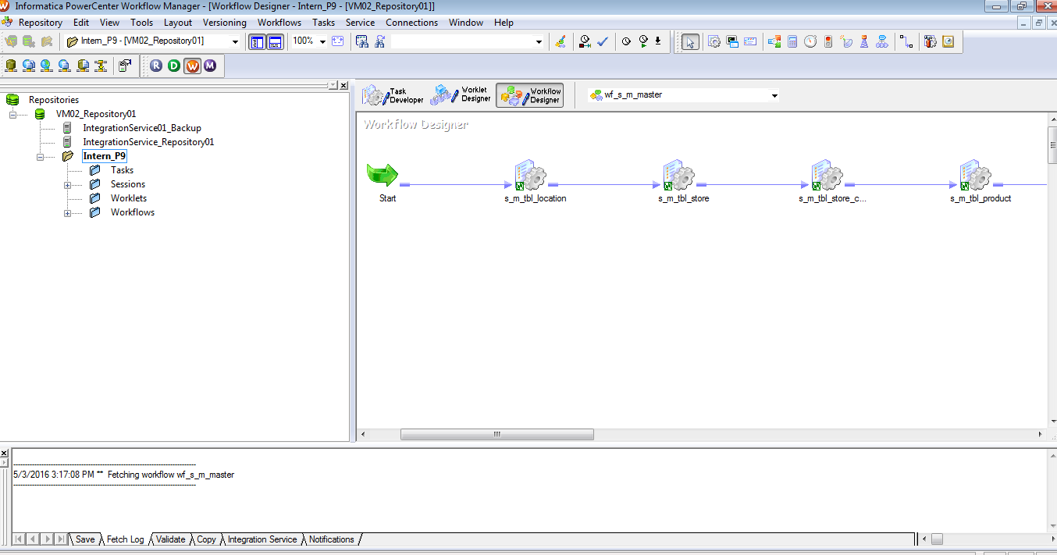
Fig. illustrating the Workflow manager

Slide 13
Step 3
After the successfully execution of workflow Manager Now we can observe the results in Workflow Monitor .
The status indicates weather the session is valid or invalid .. i.e if the status is successful then it is valid otherwise it is invalid.
If it is Invalid then we can Roll Back our entire process to see where we have done mistakes , and for this we can see the session log and directly go to the faulty part of execution.
The Fig. displays as below.

Slide 14
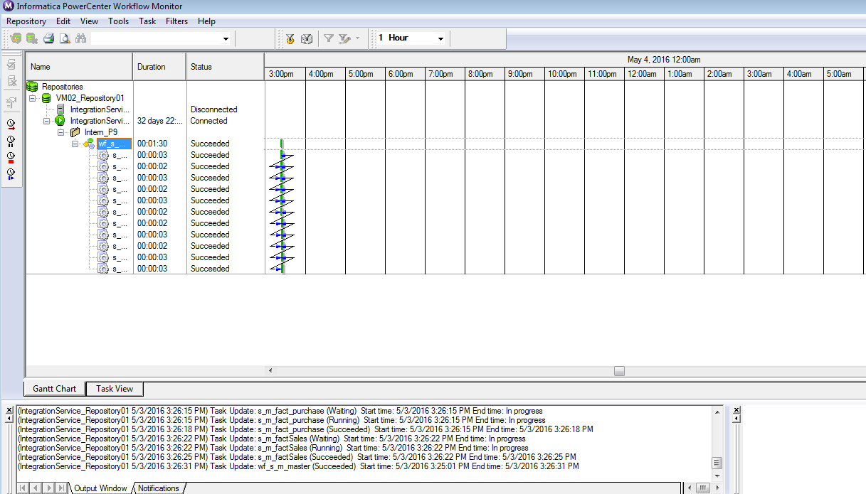
Fig. Illustrating Workflow Monitor

Slide 15
Step 4
After the successful Execution of the Workflow Monitor the target table of our expected Business requirement is now available in the SQL SERVER .
We can check out all the rows and columns and observe the requirement that we had to arrive .
It provides us a feature of Roll-Back so that if any Requirement is not met then we can again do the similar operation to produce the required output .
The Fig. describes the Target Table produced in MS SQL SERVER.

Slide 16
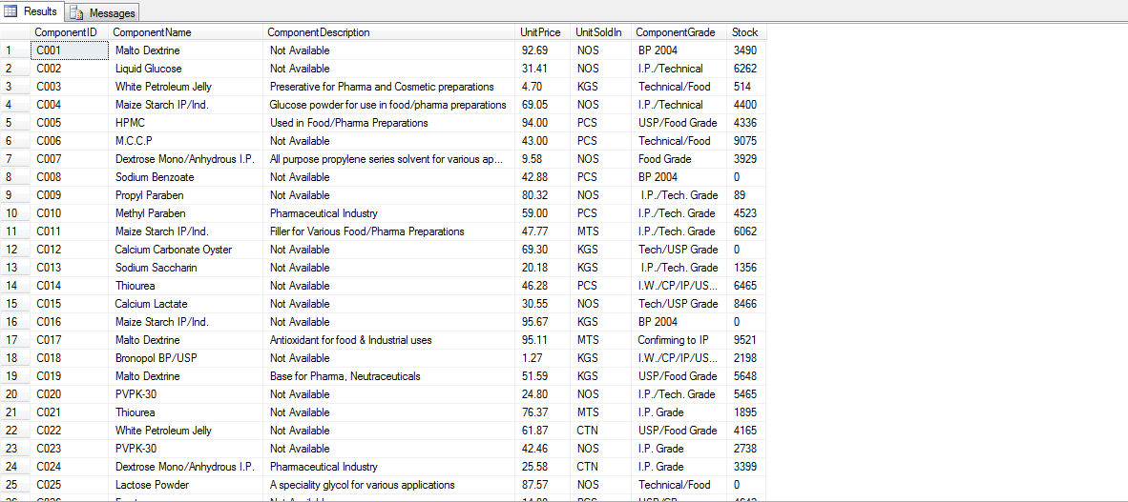
Fig. Illustrating Target Table In MS SQL SERVER

Slide 17
Step 5
Now we have already created a Data warehouse and Need to load it in to Framework Manager to create a Package .
In order to doing so we have to eliminate three Anomalies which includes 1. self Loop 2. Role Playing Dimension 3. Loop these things are to be done in Physical view
In Business View we have to undergo the business requirements .
In Presentation view we have to classify Dimension and Fact in separate folder .
After completion of all the three views we have to Publish the package so that we can create a Report based on the created Package.

Slide 18
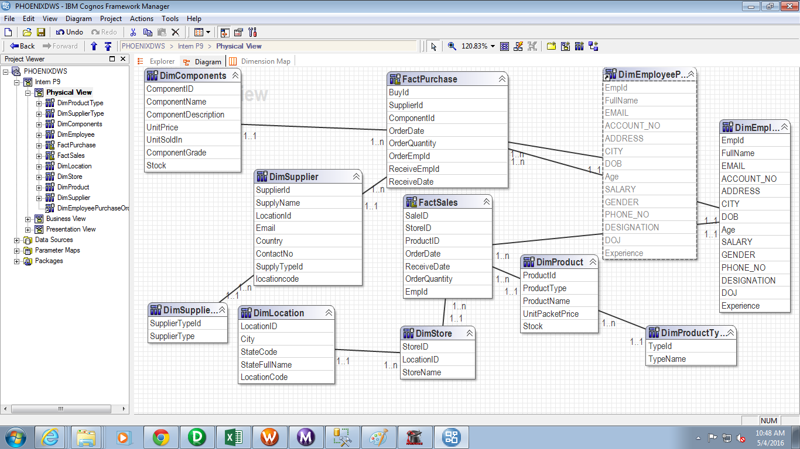
Fig Illustrating Framework Manager

Slide 19
Step 6
Once we Published the package we have to create report based on this Package .
For creating Dashboard we are using IBM Cognos Reporting Studio where we can apply Pie-Charts , Crosstabs, Tables and many more functionality according to the requirement of Client to make it Visible in an attractive manner so that easily the decisions can be taken by looking at the Reports .
A sample Report is Given here for the Published Package .

Slide 20
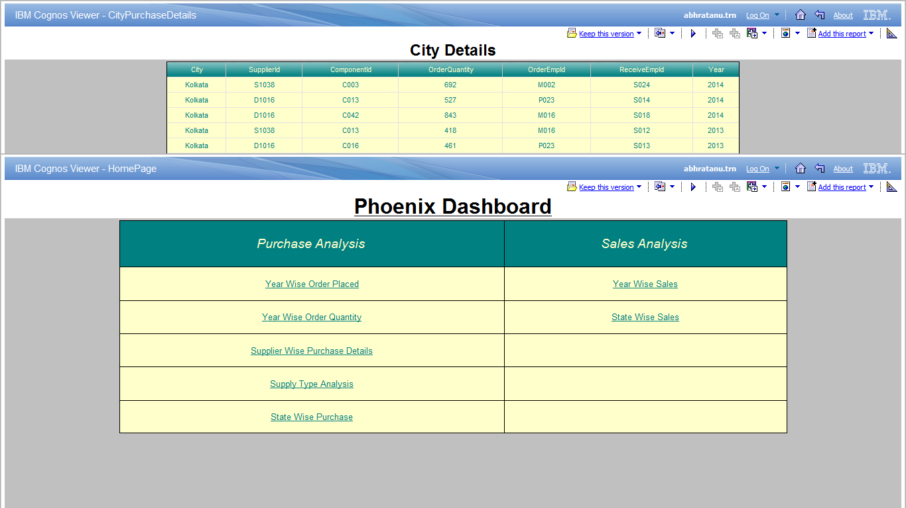
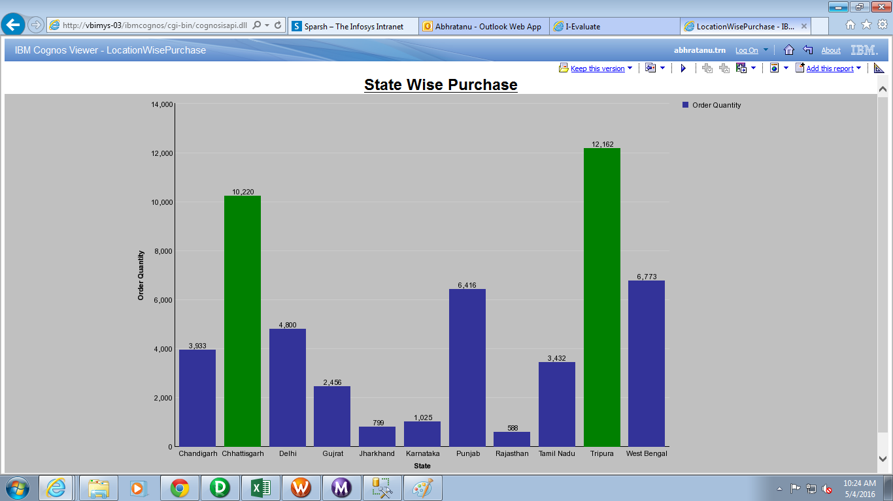
Fig Illustrating The Reporting Studio

Slide 21

Future enhancement Of The Project
Data Mining
Data Cubes
Analyzing
THANK YOU

